Slide 1
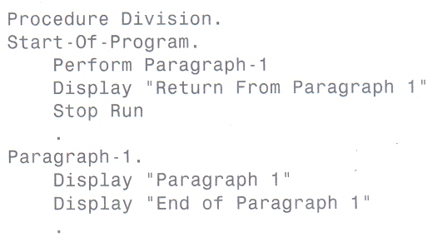




The Basic PERFORM Statement
The perform statement executes the code you specify after the Perform
and then returns in your program to the point after the Perform statement.
FEU – EAST ASIA COLLEGE
Information Technology Department

Slide 2
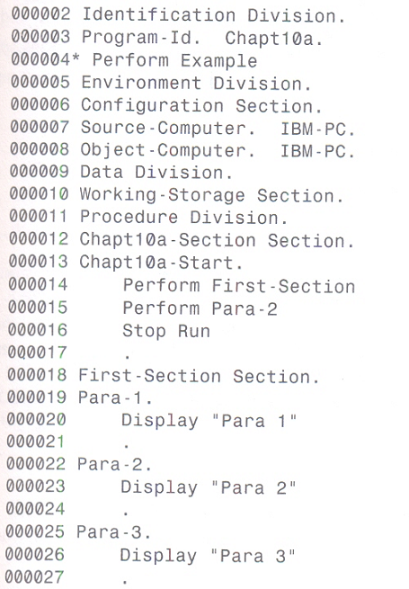
Sections and
Paragraphs
In Cobol you can divide the Procedure Division into Sections, using Section headings.
A Section can have many Paragraphs which are performed from the top down.

Slide 3

Aside from performing a Section or a Paragraph, you may perform a range of paragraphs.

Slide 4
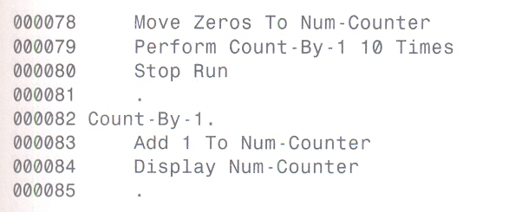
Creating Loops using PERFORM
Using perform to perform a paragraph multiple times.

Slide 5
Creating Loops using PERFORM
In addition to performing a paragraph a certain number of times, you can base a perform on a conditional test by using Until.
With Until you tell the program to perform the paragraph, testing for your condition before every execution of the paragraph, until the condition is true. All statements under the paragraph are executed. The test for your condition occurs before the paragraph is next executed. If your condition is true, the paragraph is not executed.

Slide 6
Creating Loops using PERFORM
100-Main-Routing.
Move “A” to Test-Item
Perform Para-1 Until Test-Item = “A”
Stop Run.
Para-1.
If Data-A + Data-B = 25
Move “A” to Test-Item
End-if

Slide 7
Creating Loops using PERFORM
100-Main-Routine.
Move Zeros to xctr.
Move 1 to num-prod.
Perform Count-Routine Until xctr >= 3.
Display “Number Product : “ with no advancing.
Display num-prod.
Stop Run.
Count-Routine.
Add 1 to xctr
Compute num-prod = num-prod * xctr.

Slide 8
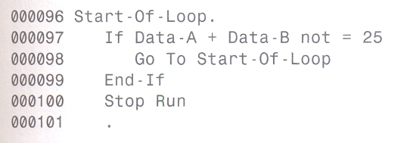
Use of GO TO
The Go To causes the program to jump to the paragraph title or section header specified in the Go To statement.
Go To causes what is referred to as an unconditional branch. The logic of your program jumps to the point of the Go To and does not return, in contrast to the logic of a Perform.

Slide 9
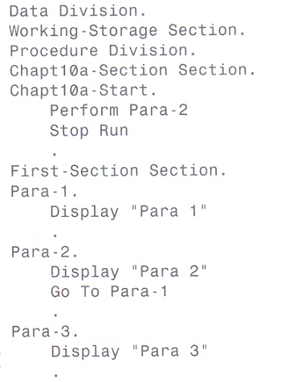
Use of GO TO

Slide 10
Advanced PERFORM Statement
Using Perform with Varying
Testing before and after the Perform
Using inline Perform statements
Nesting Perform statements
FEU – EAST ASIA COLLEGE
Information Technology Department

Slide 11
Perform with Varying
Important points to remember about using Varying:
1.) Specify first a numeric data item (counter) you
are going to adjust.
2.) Set an initial value of the data item after the
word From.
3.) The counter is adjusted by the amount specified
after the word By.
4.) The condition after the word Until is tested
before the Perform is executed.

Slide 12
Perform with Varying
Example:
Data Division.
Working-Storage Section.
01 Counter Pic 9(2) value zeros.
Procedure Division.
100-Main-Routine.
Perform Count-Routine Varying Counter
From 1 By 1 Until Counter = 5
Stop Run.
Count-Routine.
Display Counter.

Slide 13
Testing Before or After
This option causes the Perform to test the condition immediately after the Perform has been executed and before any adjustment is made by the use of Varying.
Procedure Division.
100-Main-Routine.
Perform Count-Routine With Test After Varying Counter From 1 By 1 Until Counter = 5
Stop Run.
Count-Routine.
Display Counter.

Slide 14
Inline Perform
The Inline Perform has all the characteristics of a regular Perform with two (2) exceptions:
1.) It is always terminated with the explicit scope
terminator, End-Perform.
2.) It has no paragraph or section name to be
performed. The statements that are to be
performed are coded between the Perform
statement and the End-Perform scope
terminator.

Slide 15
Inline Perform
Procedure Division.
100-Main-Routine.
Perform With Test After Varying Counter
From 1 By 1 Until Counter = 5
Display Counter
End-Perform
Stop Run.

Slide 16
Inline Perform
Procedure Division.
100-Main-Routine.
Perform Varying Counter From 1 By 1
Until Counter > 5
Divide Counter by 2 giving xTemp
Remainder xRem
if xRem = 0
Display Counter
End-if
End-Perform
Stop Run.

Slide 17
Nesting Perform Statement
Multiple Perform statements can get confusing, especially when the paragraphs being performed are scattered throughout your source code. Inline Performs can be used inside these performed paragraphs. Additionally, you may also nest inline performs.
Perform 10 Times
Perform 20 Times
Add 1 to xItem
:
:
End-Perform
End-Perform
When nesting performs, it is a good idea to keep the End-Perform explicit scope terminator lined up with the perform statement to make the source code more readable and easier to follow.

